Slide 1
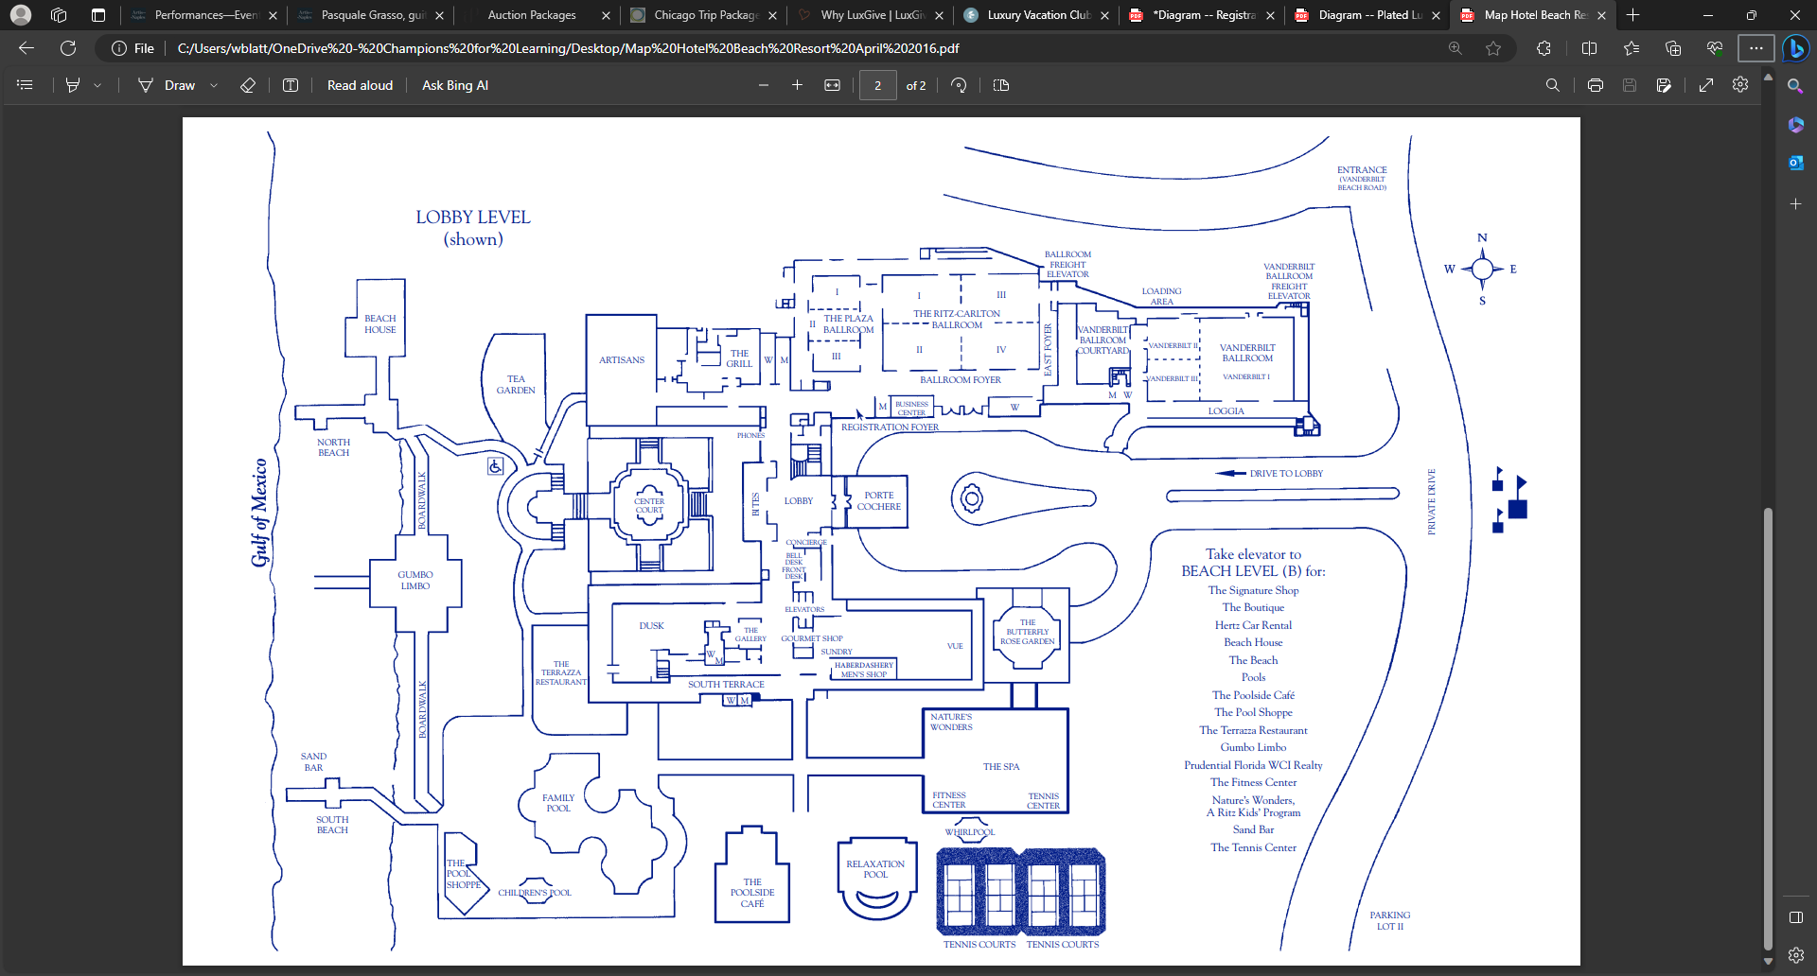
Guest Valet
5:30pm
Staff Valet

Slide 2
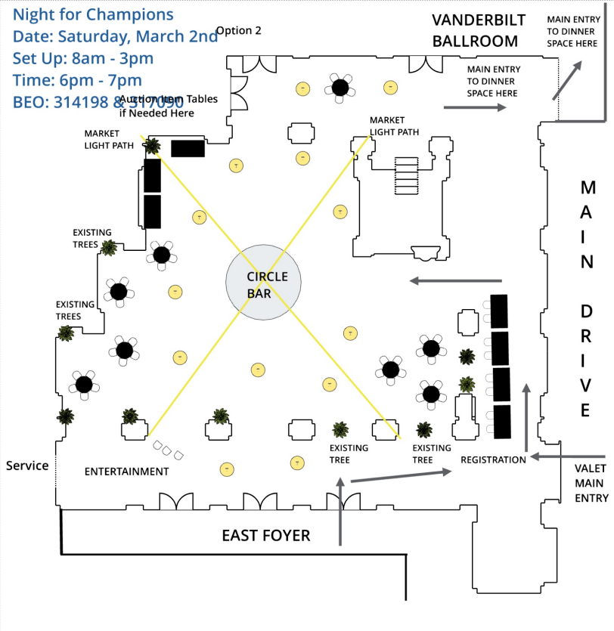
Cocktail Reception/ Check-in
Single
BAR
Stations
1. Guest Check In
2. Guest Name Tags
3. Program Interactions
Set Up
(26) Cocktail Tables
(1) Double Bar
(1)Single Bar (Closes/Break
down at 6:40pm)
(2) 8ft Tables
(1)6ft Table
(8) Chairs
Rope and Stanchion
Double BAR
3
BAND
cv
2
1

Slide 3
Guest Departure/ Checkout
Stations
1. Guest Directing
2. Guest Check Out
Assistance
3. Sweet Sendoff
4. Name Tag Collection
Set Up
1. (3) Tables
2. (6) Chairs
3. Rope & Stanchion
Short Pipe & Drape
1
3
2
cv
4

Slide 4
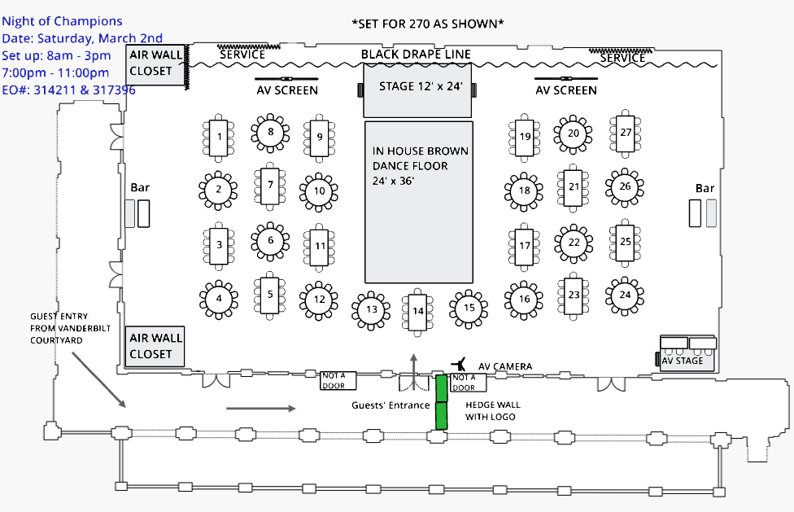
Tables 9 & 24 Receive the Designated Servers
TABLE NUMBERS
1
8
9
16
23
24
31
32
29
2
7
10
15
22
25
30
33
28
3
6
11
14
21
26
29
34
4
5
12
13
17
18
19
20
27
28
35

Slide 5
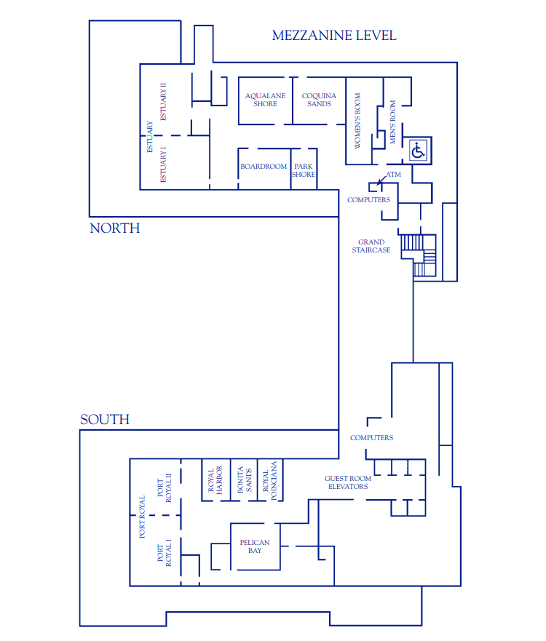
Green Room
Dinner Staged Outside Room
Storage

